Slide 1



VAGA TRIP
Utsav Gohel
TD1 - 91900104011
B.Tech Information Technology
Software Developer Intern at VAGA TRIP

Slide 2
Internal Guide
Prof. Yatri Dawda
Department of Information Technology
Project Mentor
Mr. Parth Patel
Senior Developer at VAGA Trip

Slide 3
Outline
Abstract
Functionalities
Background Work
Technology & Methodology
Database Design
UML Diagrams

Slide 4
Some Facts about Travel Industry
According to the goodworklabs –
It is the 7th most downloaded app category
85% use smart-phones to plan their travel when on leisure tours
72% people will post photos about their travel on social platforms like Facebook
46% check-in via their smart-phones when on holidays
30% use mobile apps to find the best hotel deal
29% use mobile apps to find the best flight deals
15% users specifically download travel apps to plan a trip ahead

Slide 5
Abstract
The "last-minute cancellation" of a vacation is a true issue that many of us experienced while travelling. Finding a travel companion with comparable interests and a common language is difficult and stressful for an individual. Well, this software solution will help you solve the issue. I will be working on several discussed features which will be a part of a bigger product.
The Application is using Cloud API that helps users for faster communication between Client GUI and server.
The Application is to be hosted in AWS Cloud, for faster optimization and Scalablility
In future our Application will be, one of Travel Social Network for tourists.

Slide 6




Functionalities
Search Destination
Get Connected
Search and select the destination u want to travel to.
When u find someone that you want to meet up with, click the connect button and start chatting with them
Trip Together
Find Travel Partners
Plan together, Meet up with your travel companion at a pre-decided public place and travel together
Browse through the list of trips, locals and nearby user in that location

Slide 7
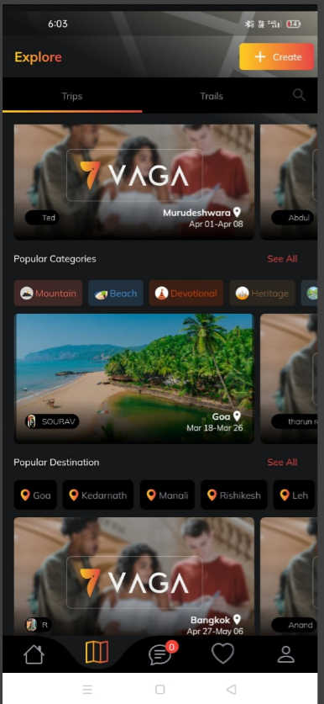
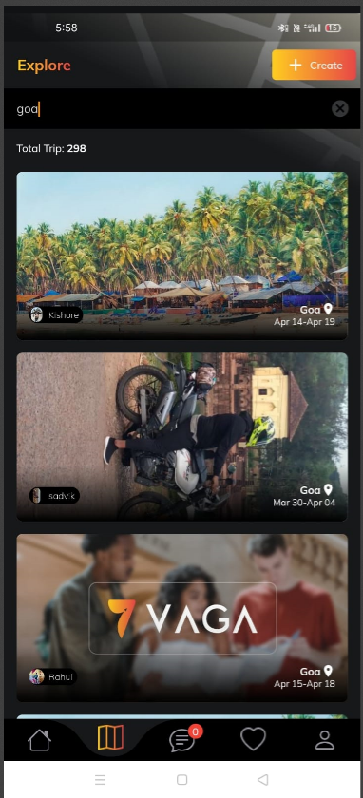
Functionalities
Search Destination
Search and select the destination u want to travel to.

Slide 8
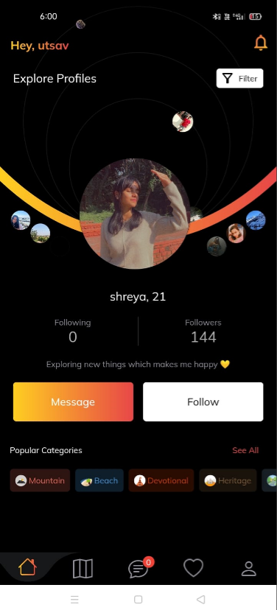
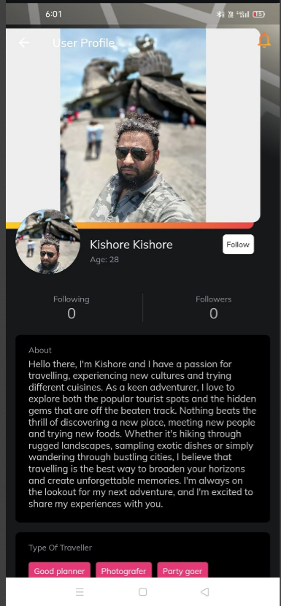
Functionalities
Find Travel Partners
Browse through the list of trips, locals and nearby user in that location

Slide 9
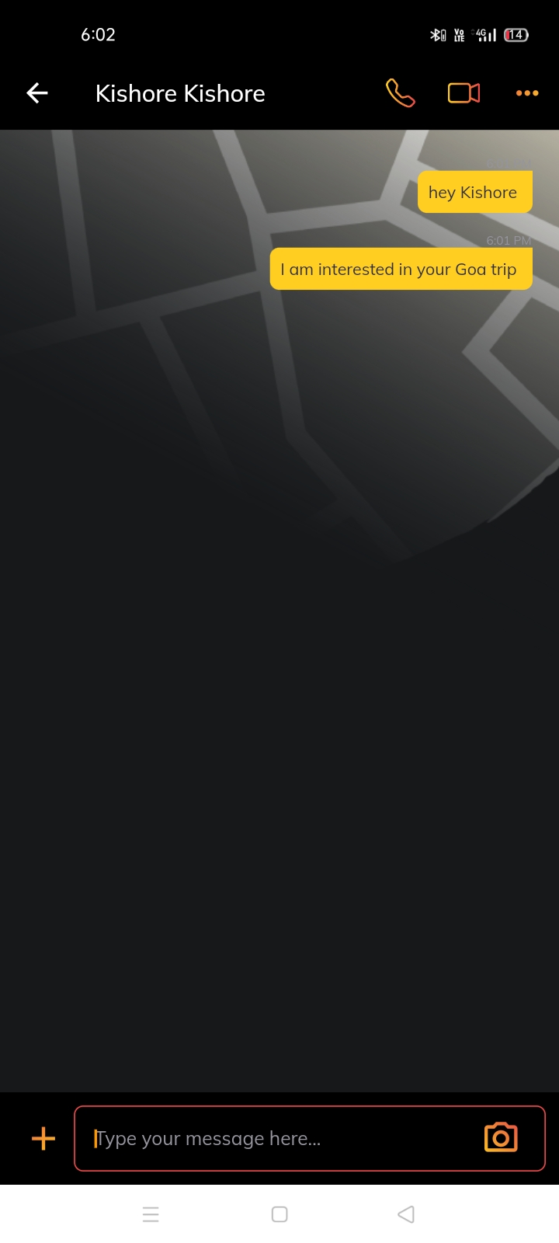
Functionalities
In Message Box
User can communicate via
Text
Image Media
Video Media
Audio Media
Also can share audio, video, image and text
Also user can perform
voice call
Video call
Get Connected
When u find someone that you want to meet up with, click the connect button and start chatting with them

Slide 10
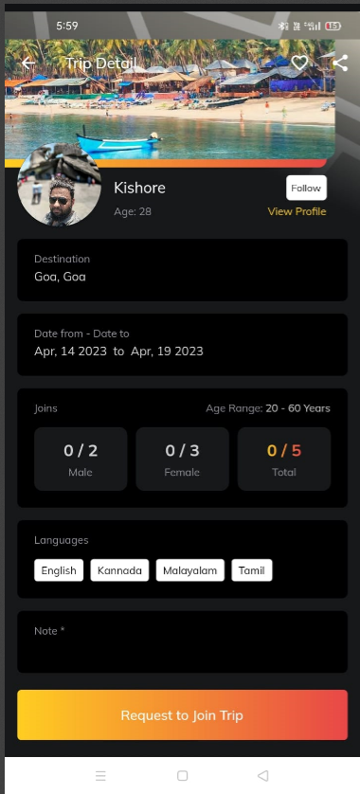
Functionalities
Trip Together
Plan together, Meet up with your travel companion at a pre-decided public place and travel together

Slide 11
Background Work - Literature Review,
“Design plays an important role in development”
Design plays a crucial role in the development of a user-friendly app. The design of an app affects the user's first impression, engagement, and overall experience with the app[2]. A well-designed app should be intuitive, easy to navigate, visually appealing, and accessible to all users.
Good design also helps in making an app more functional by ensuring that users can easily find and access the features they need. The use of consistent design elements such as color schemes, typography, and layouts can create a sense of familiarity and ease of use for users.
In addition, user testing during the design process can help identify usability issues and allow for improvements to be made before the app is launched. Ultimately, a user-friendly app can lead to higher user engagement, retention, and satisfaction, which can contribute to the success of the app.
“Always uptime” by AWS Cloud hosting
Amazon Web Services (AWS) provides a highly reliable cloud infrastructure that supports high levels of uptime for applications and services. AWS offers multiple availability zones (AZs) within each region, which are isolated data centers with their own power, cooling, and networking infrastructure. This architecture allows for redundancy and fault tolerance, ensuring that if one AZ experiences an outage, other AZs can continue to operate without interruption.[5]
Operation of the Application can de dependent on the performance
Application would be deployed in cloud, so less chances of Downtime

Slide 12
In addition to AZs, AWS also offers a range of services and features that can help ensure high levels of uptime. For example, AWS Elastic Load Balancing automatically distributes incoming traffic across multiple instances to prevent overloading and improve availability.
Overall, AWS provides a highly reliable cloud infrastructure that can help ensure uptime for applications and services.[5] By utilizing features such as multiple AZs, load balancing, auto scaling, and monitoring, developers can build highly available applications that are able to withstand unexpected events and maintain high levels of uptime.
3. “Faster optimization with API”
Node.js is a runtime environment that allows developers to build scalable and high-performance applications using JavaScript. Node.js also provides a built-in API that developers can use to create web servers, which can handle incoming requests and return responses.
One reason why Node.js API can be faster than other traditional server-side technologies is its non-blocking I/O model. Node.js uses an event-driven architecture that allows it to handle many simultaneous connections without blocking the main thread of execution.[6] This means that requests can be processed more quickly and efficiently, leading to faster response times and overall performance.
Additionally, Node.js API benefits from the ability to leverage JavaScript's asynchronous programming capabilities. By using asynchronous programming techniques, Node.js can handle multiple requests simultaneously without waiting for each request to complete before moving on to the next one[6]. This approach allows Node.js API to make more efficient use of server resources, resulting in faster and more responsive applications.

Slide 13




Technology
Figma & Flutter for Frontend UI
NodeJS and ExpressJS for API and Server
Database will be stored in MySQL
Application is hosted using AWS cloud

Slide 14
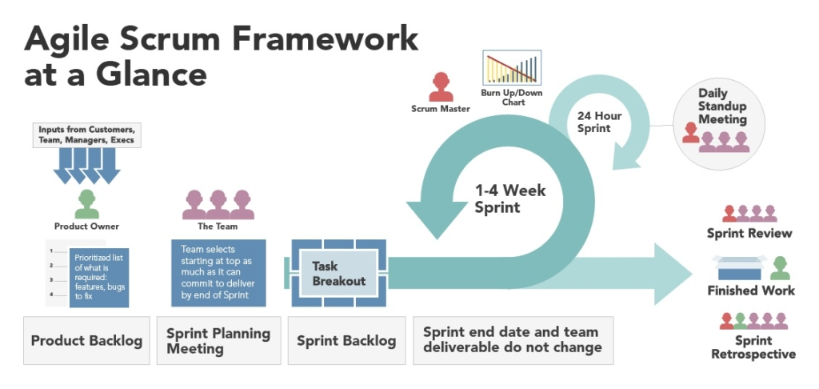
Methodology

Slide 15
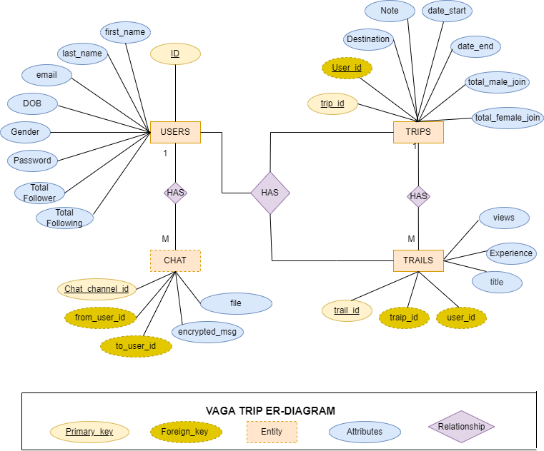
Database Design

Slide 16
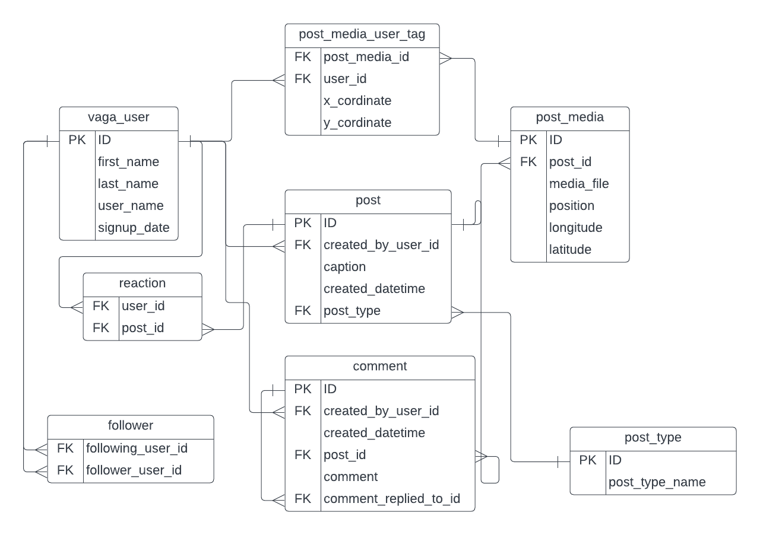
New Feature Database design “Post-Integration”

Slide 17
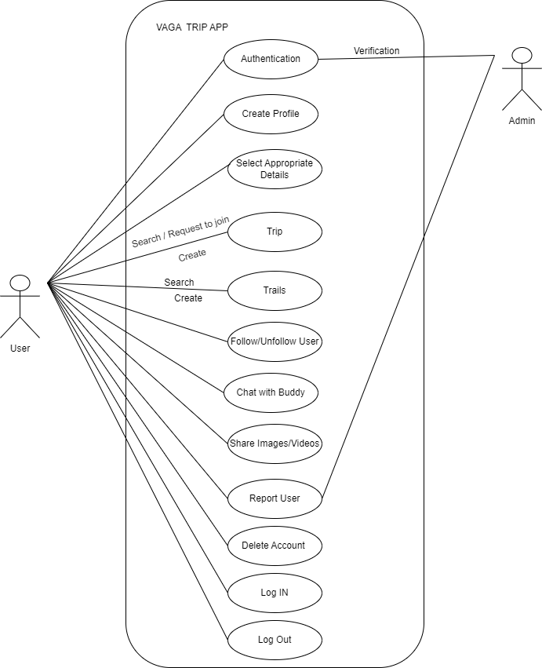
UML diagram is visually representing a Travel system along with its main actors, roles,actions, artifacts or classes.
UML diagram

Slide 18
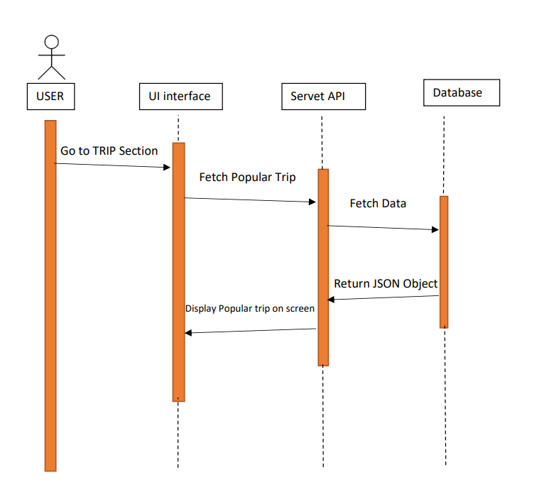
Sequence Diagram

Slide 19
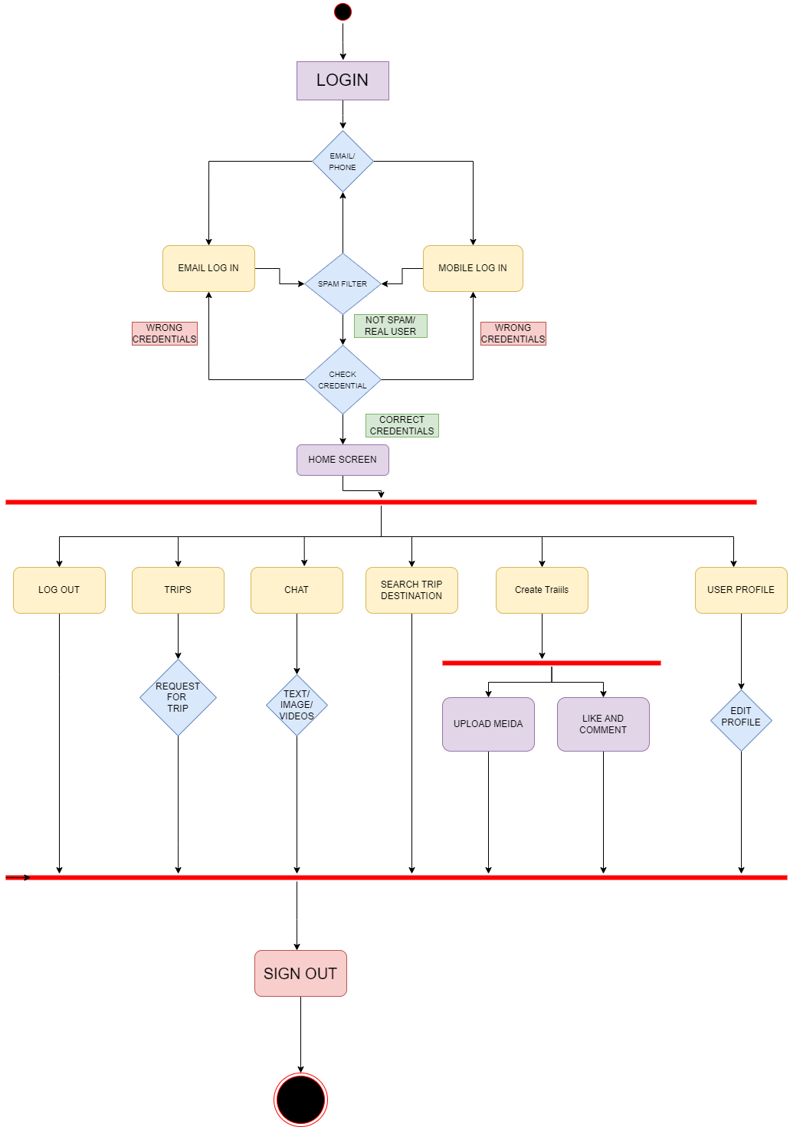
Activity Diagram

Slide 20
Review 2
Suggestion Update
Comments:
Authentication
Registration

Slide 21
1. Authentication
Authentication in an app refers to the process of verifying the identity of a user who is trying to access the app or its resources.
This is typically done by requiring the user to provide some form of credentials, such as a username and password, or by using biometric factors like fingerprint or face recognition.
To have Authentication in our app, we have used four ways of Authentication which are
Mobile number (OTP based) WhatsApp, SMS
Google Account username and password credentials,
Facebook Account username and password credentials,
Apple Account username and password credentials,
By using this credentials, we can do Authentication of user in our app
Soon, In next update we have integrated biometric factors like fingerprint for Authentication process

Slide 22
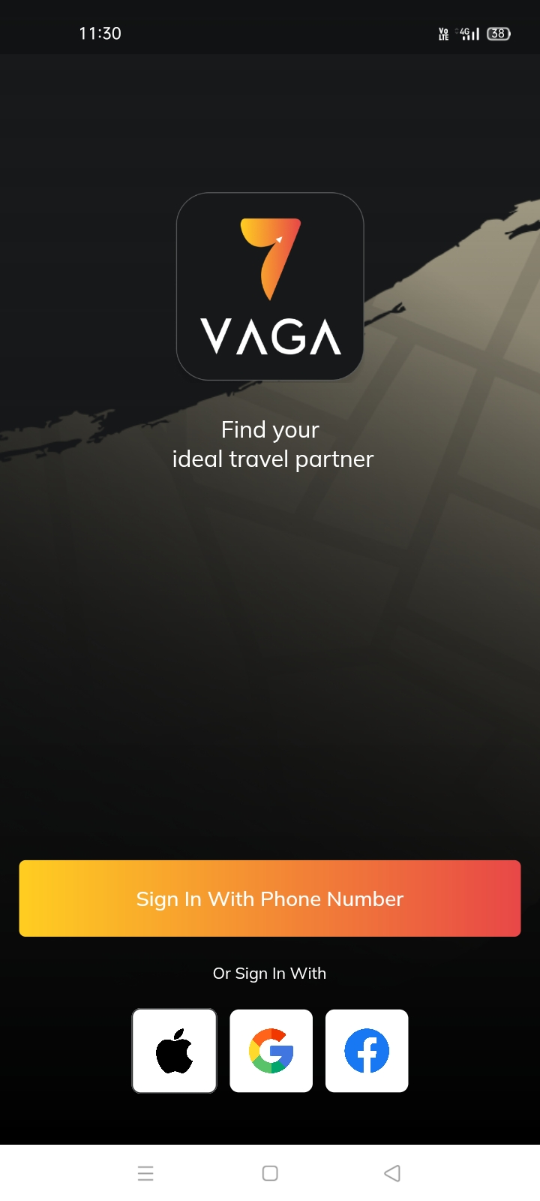
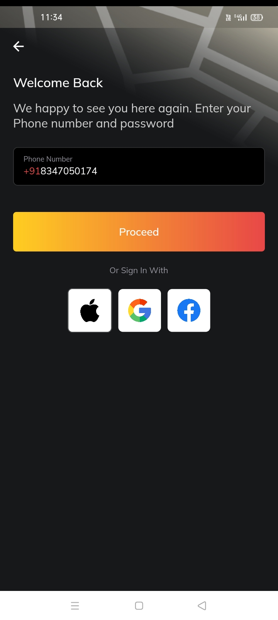
1. Authentication

Slide 23
2. Registration
Registration in an app refers to the process by which a user creates an account or profile within the app.
This typically involves providing some personal information, such as a username, email address, and password, which will be used to identify and authenticate the user.
Steps to Register yourself as VAGA User in app
My profile
Verify my Profile
Upload document
Upload selfie
Enter proper Data as per documents
Verify email and number
Done
Soon you will get orange tick on profile

Slide 24
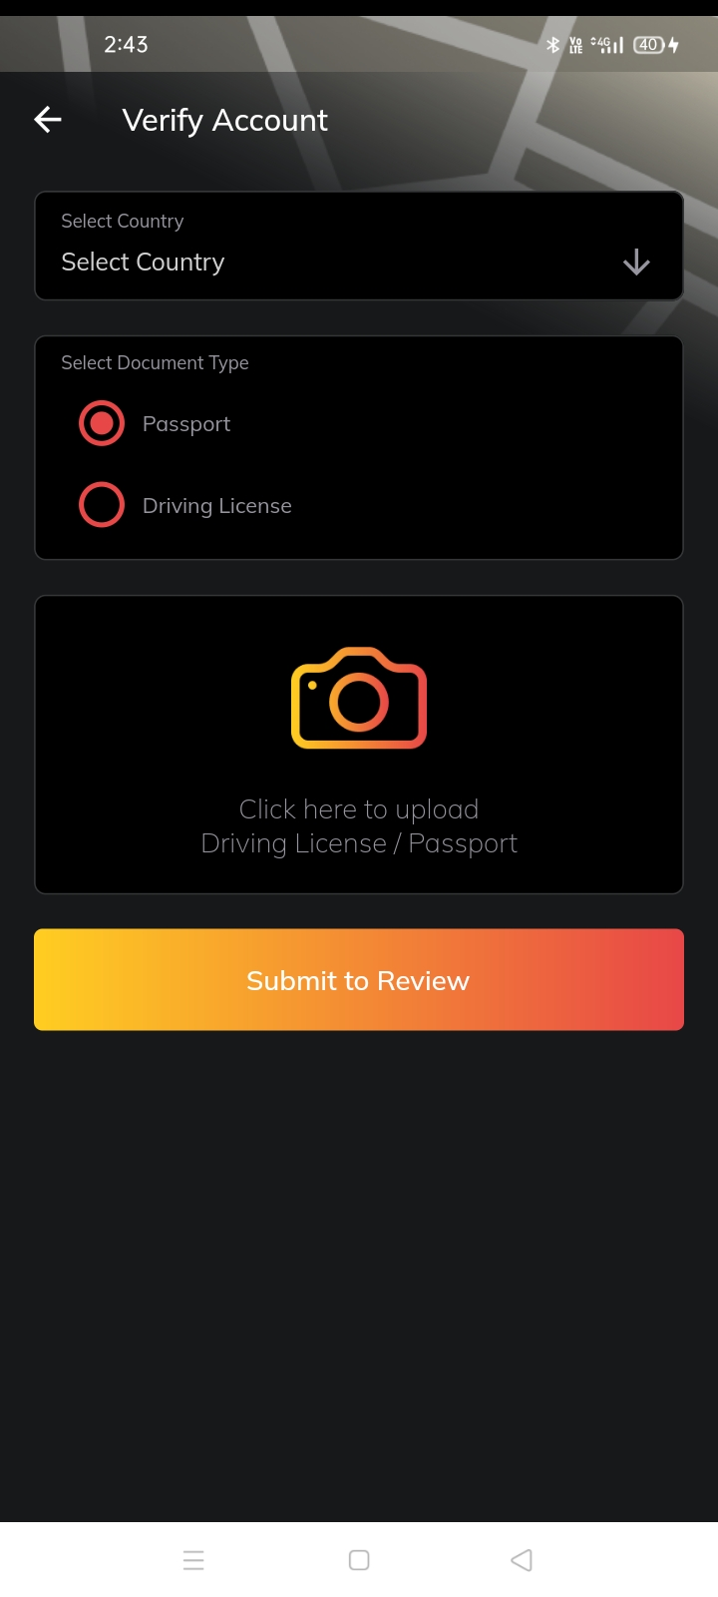
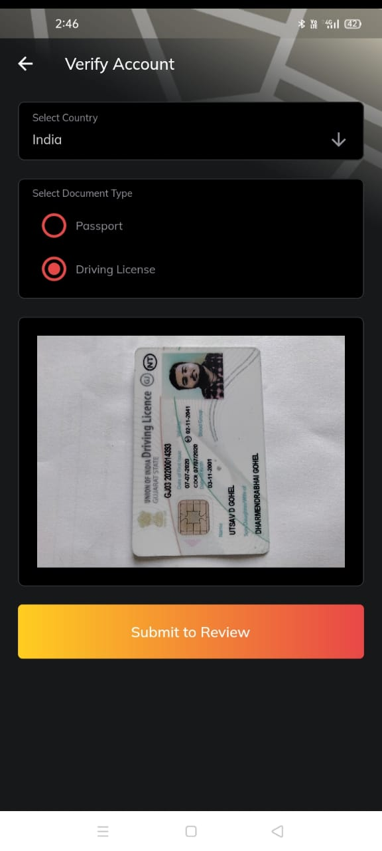
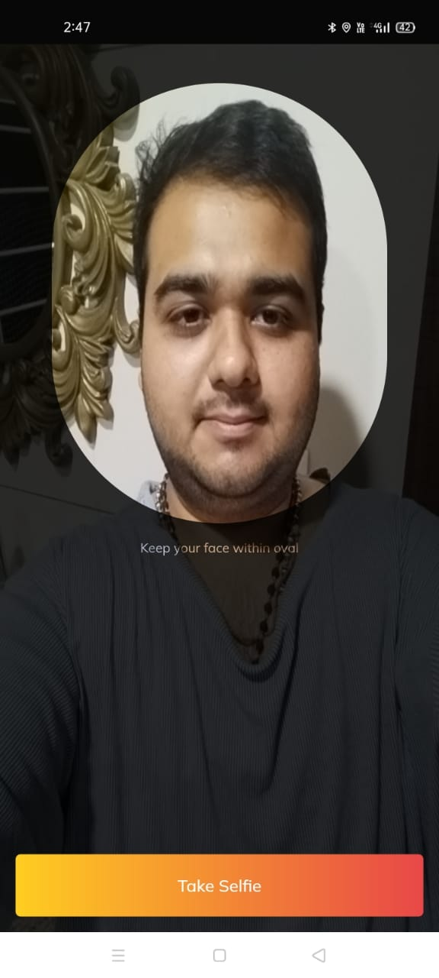
2. Registration

Slide 25
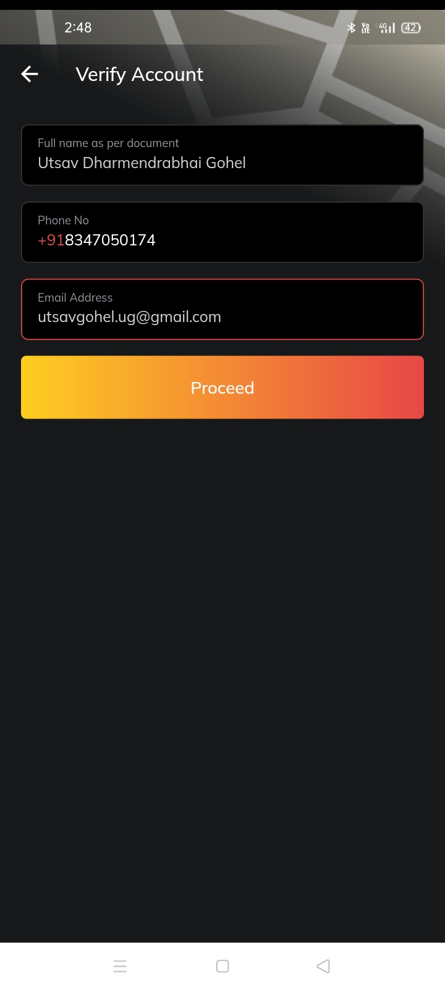
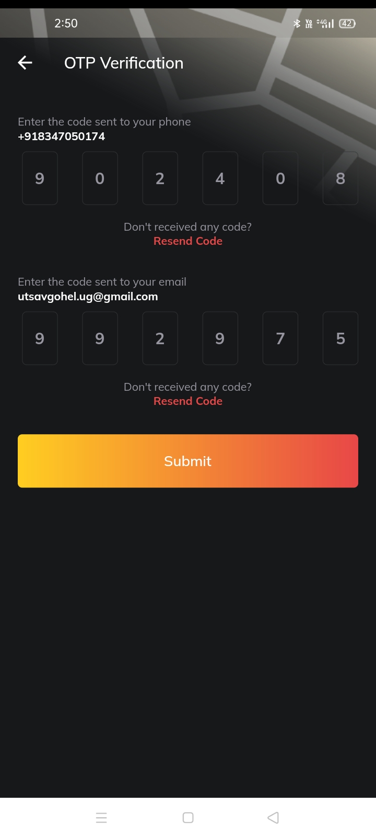
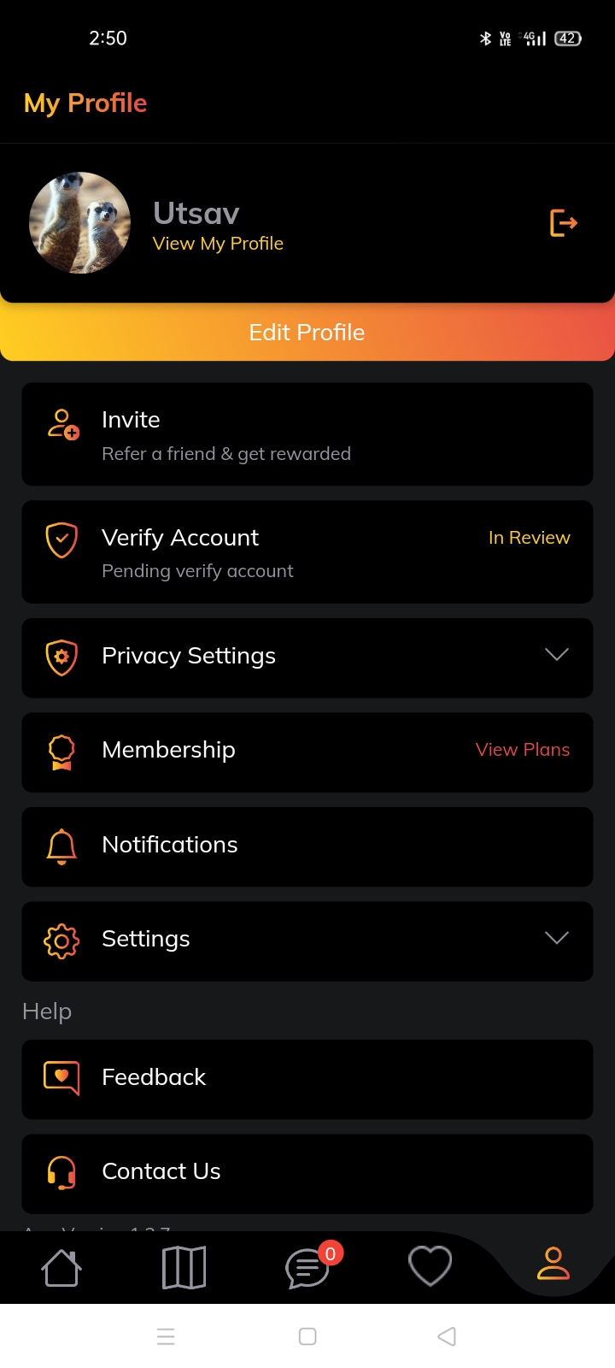
2. Registration

Slide 26
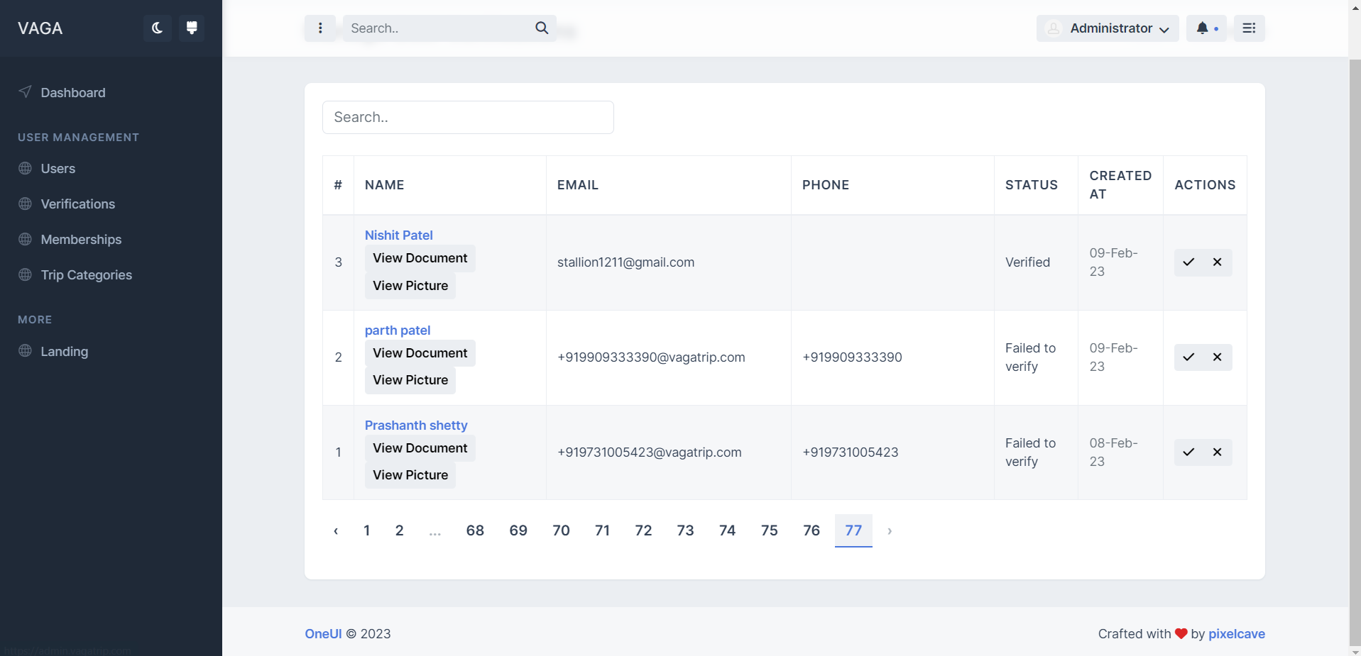
2. Registration

Slide 27
References
[1] A. B. Yahaya, "A Distributed Information System for Tourists: A Case Study of Niger State Tourism Destinations," Master's thesis, unpublished, 2010.
[2] "Literature Review," [Online]. Available: https://libguides.usc.edu/writingguide/literaturereview.
[3] S. M. Abdulhamid and G. Usman, "Destination Information Management System for Tourist," arXivpreprint arXiv:1402.1243, 2014.
[4] A. H. Agboola, A. J. Gabriel, E. O. Aliyu, and B. K. Alese, "Development Of A Fuzzy Logic Based Rainfall Prediction Model," International Journal of Engineering and Technology, vol. 3, no. 4, pp. 397-404, April 2013.
[5] B. Wong, I. Stoyanov, and E. G. Sirer, "Octant: A Comprehensive Framework for the Geolocalization of Internet Hosts," in Proceedings of the Symposium on Networked System Design and Implementation, Cambridge, Massachusetts, April 2007.
[6] L. Cao and F. Tay, "Financial Forecasting Using Support Vector Machines," Neural Comput & Application, vol. 10, pp. 184-192, 2001.
[7] D. Li, J. Cheny, C. Guo, Y. Liu, J. Zhangy, Z. Zhang, and Y. Zhang, "IP-Geolocation Mapping for Involving Moderately-Connected Internet Regions," Technical Report, 2009.
[8] D. Chatzopoulou and M. Kokkodis, "IP Geolocation," Computer Science and Engineering Dept UC Riverside Technical Report, 2007.
[9] H. L. S. Berger and F. Lehner, "Location-based information services in the tourist industry," Journal of Information Technology & Tourism, vol. 5, pp. 243-256, 2003.
[10] "What is Cloud Computing?" [Online]. Available: https://aws.amazon.com/what-is-cloud-computing/?nc2=h_ql_le_int_cc.

Slide 28
Find Buddy
Hobbies
Passion
Share your
Hobbies that u do in
Ur free time
Share your working
Professional
What type of traveller
Nationality
Select whether ur student, tourist, NRI, Trip vendor
Select the nation u are living

